Slide 1
SCOTLAND
IN FILM

Slide 2
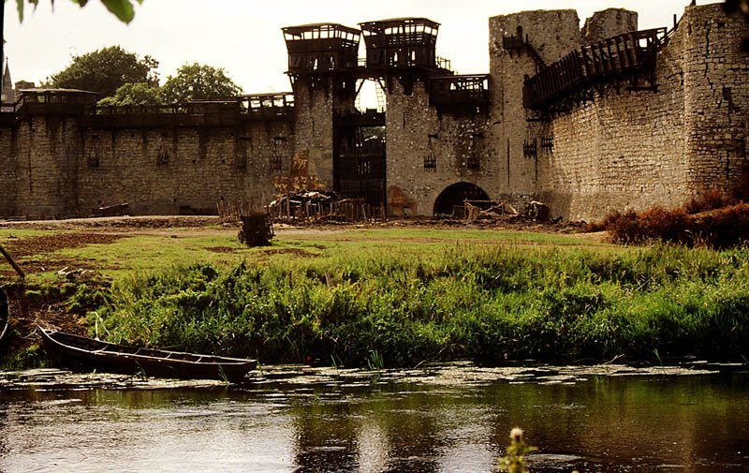
Trim castle
Medieval York - Braveheart

Slide 3
It's not only Scottish acting talent that shines on screen!
Scotland's stunning scenery has also been the star of many film and TV productions.

Slide 4
In 1995, Braveheart burst onto cinema screens on its way to becoming a multi-Oscar winning film of epic proportions.
A fiercely Scottish movie, steeped in the history and culture of the country, the movie evoked a real sense of patriotism for the more than 50 million people around the world who claim Scottish ancestry..

Slide 5
Whether it’s our stunning scenic landscapes, our awe-inspiring historic buildings or our vibrant cities, Scotland has become a magnet for the film and TV industry in the years since a blue-faced Mel Gibson cried FREEDOM!!! –
in fact we’ve become the backdrop for many more productions than you might expect.

Slide 6
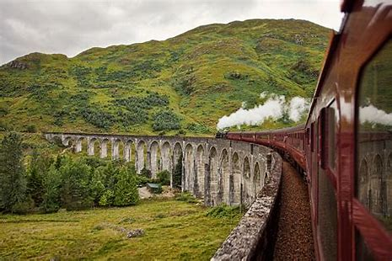
Glenfinnian Viaduct
Harry Potter

Slide 7
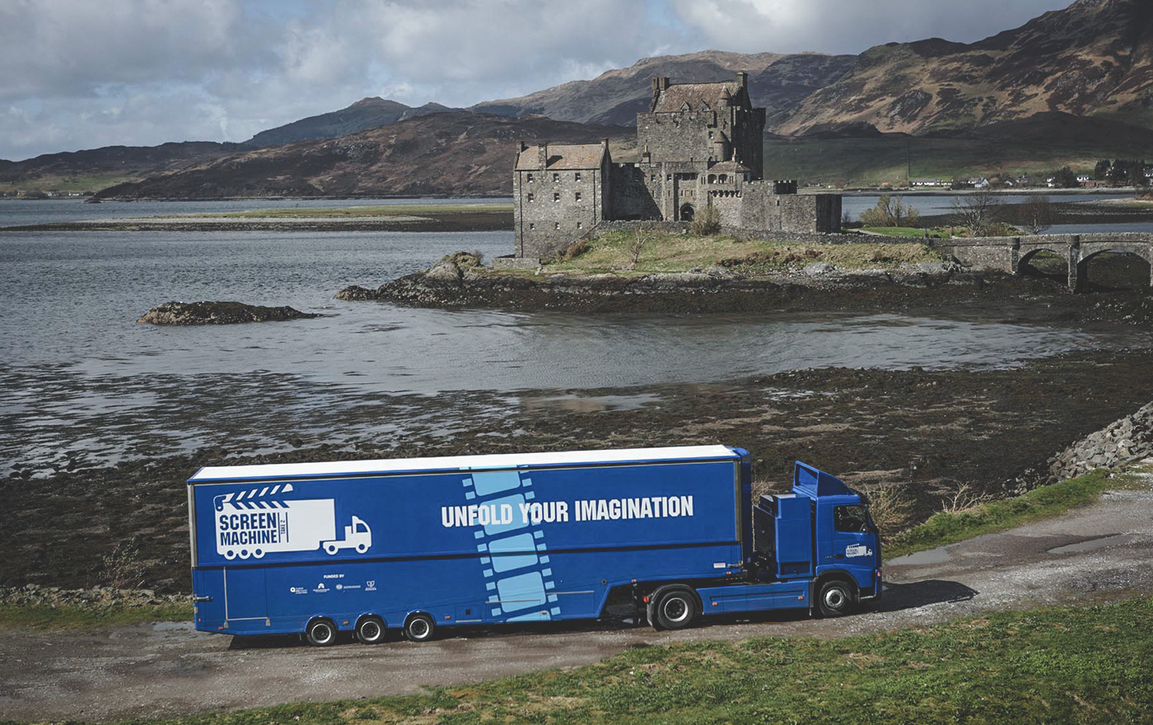
Eilean Donan Castle
The Highlander

Slide 8
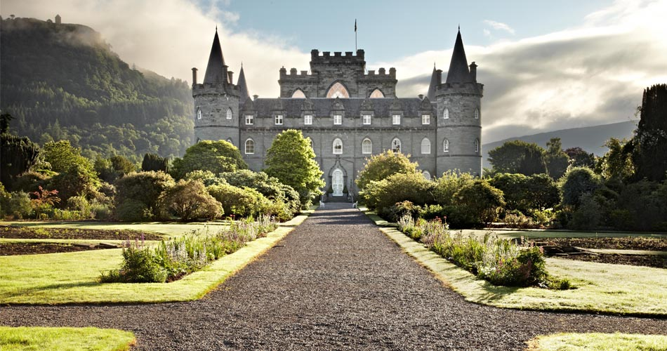
Inveraray Castle
Downton Abbey

Slide 9
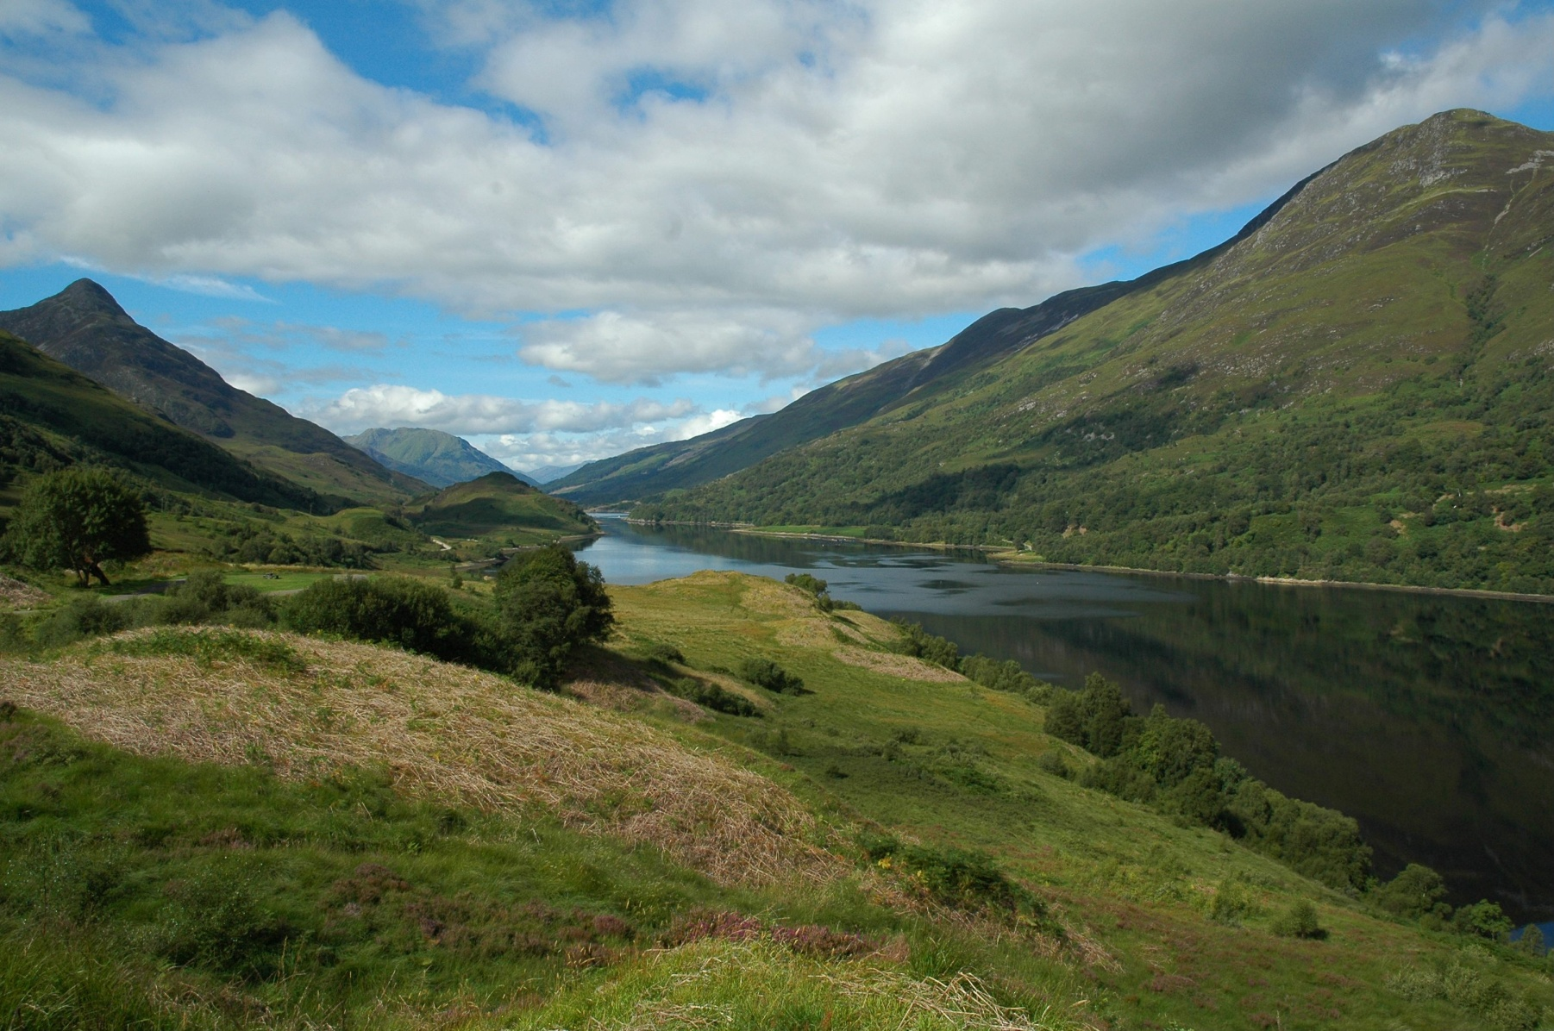
Loch Leven Highlands
Braveheart 1995

Slide 10
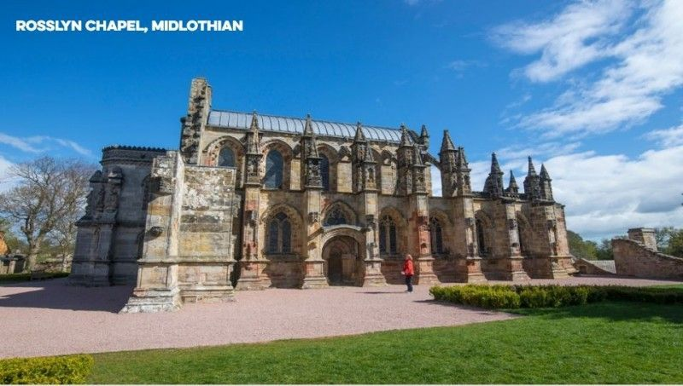
Da Vinci Code 2006

Slide 11
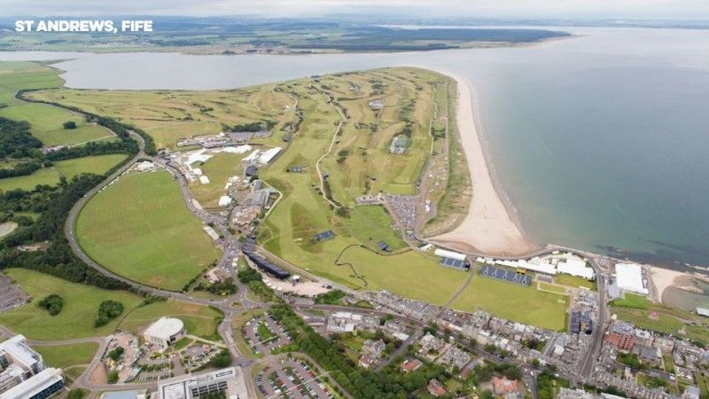
St Andrews Fife
Chariots of Fire 1981

Slide 12
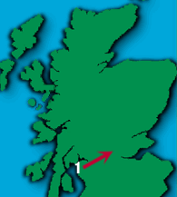
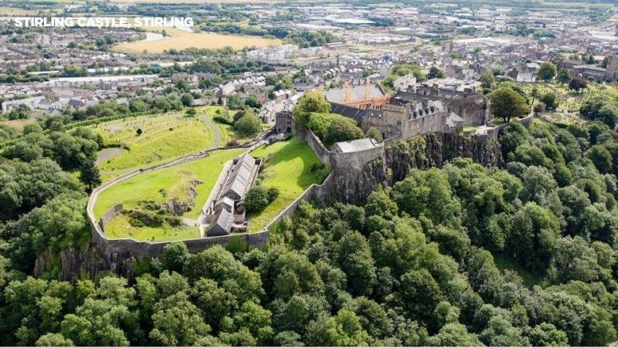
Stirling Castle
Stirling Castle
To end all wars 2001

Slide 13
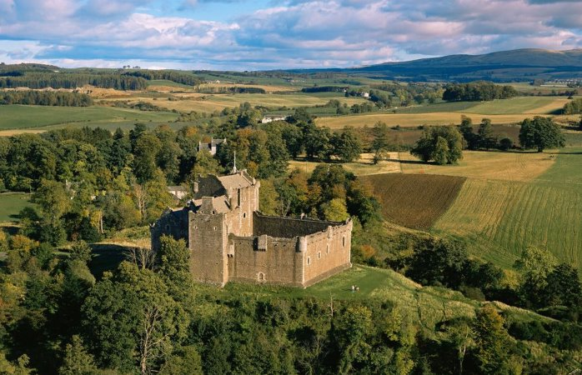
Doune Castle
Monty Python – The Holy Grail

Slide 14
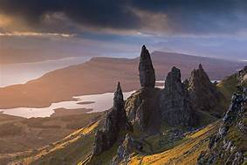
Old man of Storr

Slide 15
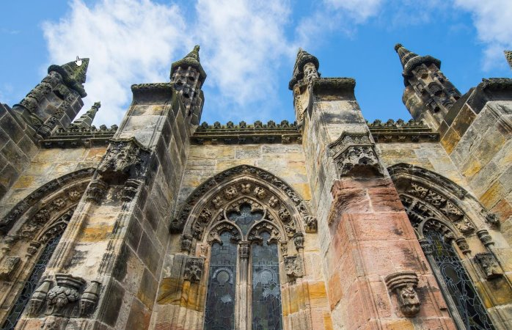
Rosslyn Chapel
The DaVinci Code

Slide 16
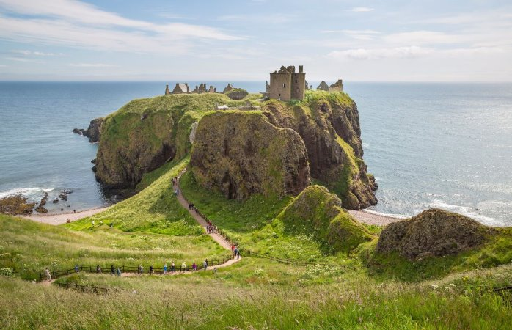
Dunnotar Castle
Brave

Slide 17
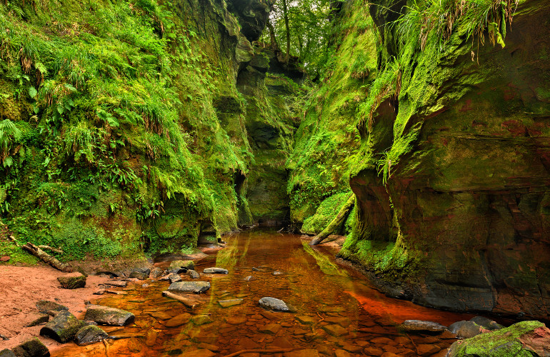

Slide 18
Great Scottish Movies
28 Nov 2012Share:
Few countries can match Scotland when it comes to dramatic scenery and our glens and lochs have featured in some of the most successful movies in cinema history. But we're not only used to providing the backdrop; over the years Scotland has produced more than its fair share of acting and directing talent.
THE 39 STEPS (1935)
Alfred Hitchcock's only cinematic venture north of the border produced this classic that is perhaps best remembered for its daring chase sequence across the Forth Bridge. Although its sense of Scottish geography is slightly off as once across the bridge the hero finds himself in the middle of the Highlands!
WHISKY GALORE (1949)
Based on the true story of a wartime ship packed with 50,000 cases of whisky that ran aground off the Outer Hebrides, Alexander Mackendrick's directorial debut is as funny today as it was over half-a-century ago. The real ship - the SS Politician - ran aground off Eriskay and it is said that one of the estimated 250,000 bottles of her whisky is still found by someone on the beach every other year.
BRIGADOON (1954)
Gene Kelly becomes enchanted by a mythical village in the Highlands in this classic musical. The village was indeed mythical, the whole film was shot on a soundstage in Los Angeles.
THE WICKER MAN (1974)
Edward Woodward stars as a policeman sent to investigate strange happenings on the remote Scottish island of Summerisle. A strange, disturbing film that was largely ignored upon its release The Wicker Man has become one of the great cult classics of modern cinema.
JUST ANOTHER SATURDAY (1975)
A stark, brutal look at sectarian violence and a grim snapshot of the No Mean City Glasgow of the early 1970s, this film is not easy viewing, but it's well worth it. Not least for a revelatory performance by the young Billy Connolly as Paddy - Connolly's first serious acting role.
THAT SINKING FEELING (1979)
Scottish uber-director Bill Forsyth's debut feature tells the story of a bunch of likely lads planning the biggest ever heist . . . of a toilet factory! A beautiful gentle comedy from the late 1970s.
GREGORY'S GIRL (1981)
Over twenty-five years on and Bill Forsyth's Cumbernauld-shot masterpiece still looks as fresh as a summer morning. As sweet a take on teenage romance as was ever filmed it's worth watching simply for Chic Murray's show-stealing performance as a pastry-loving headmaster. A joy forever.
LOCAL HERO (1983)
Forsyth's run of form continued with this (slight) remake of Whisky Galore. A Texas oilman comes to a remote part of Scotland and finds the natives are wilier than he bargained for. Beautifully shot by Oscar-winning cinematographer Chris Menges - Scotland's beaches have never looked better.
COMFORT AND JOY (1984)
A great performance by Bill Paterson as Alan Bird - a Glasgow Radio DJ suffering a mid-life crisis - lifts this film out of the ordinary, but the real star of the show is the city itself: from dusk shots of the M8 motorway to Christmas shopping on Buchanan Street, Glasgow sparkles. Oh, and there's a show-stealing cameo from the late, great Rikki Fulton as Paterson's long-suffering boss.
RESTLESS NATIVES (1985)
A little-known gem from the mid 80s tells the charming story of two Edinburgh lads who take to robbing coach loads of tourists, accidentally becoming modern-day Robin Hoods in the process. With a stirring soundtrack by Big Country.
HIGHLANDER (1986)
A soundtrack by Queen, a top-drawer cameo by Sir Sean Connery and some incredible Highland scenery all add up to raise this above the level of unashamed top-drawer escapist entertainment. Even the dated 1980's special effects don't seem to matter too much now!
SOFT TOP HARD SHOULDER (1992)
Long before The Thick of It made him a star of the small screen, Peter Capaldi wrote and starred in this touching story of a young man trying to drive from London to Glasgow to claim an inheritance. Filmed on location in Strathclyde and featuring a terrific cameo from Richard 'Victor Meldrew' Wilson this is well worth tracking down.
SHALLOW GRAVE (1994)
Three friends, one corpse and a suitcase full of money. The best advertisement for Edinburgh property ever made (and the worst for flat-sharing) Shallow Grave introduced the world to the talents of director Danny Boyle.
BRAVEHEART (1995)
Altogether now - 'FREEEDOM!'. Mel Gibson steps behind the camera to direct and achieves an unlikely feat: a Hollywood film, directed by an Australian and shot largely in Ireland which managed to become the biggest film in Scottish box-office history! It also inspired a generation of football fans to get creative with the face-paint.
ROB ROY (1995)
Rob Roy failed to achieve quite the same level of commercial success, but the film has much to recommend it: the lochs and glens of Scotland have rarely looked more beautiful and the central performances by Liam Neeson, Tim Roth and Brian Cox are simply towering.
TRAINSPOTTING (1996)
Based on Irvine Welsh's novel, Trainspotting defined the nineties and kick-started the careers of Robert Carlyle, Kelly Macdonald, Ewan McGregor, Euan Bremner and Johnny Lee Miller. The most adrenaline-fuelled look at addiction ever filmed.
MRS BROWN (1997)
John Madden directed this touching, understated look at Queen Victoria's platonic relationship with her Highland ghillie John Brown. Billy Connolly played Brown and won worldwide critical acclaim for his performance.
RATCATCHER (1999)
Written and directed by Lynne Ramsay, Ratcatcher is a haunting story of childhood set in the Glasgow of 1973. With garbage strikes, fetid canals and tower blocks forming much of the backdrop it is a tribute to the power of Ramsay's filmmaking that there is not a depressing second in this stunning, unsettling film.
SWEET SIXTEEN (2002)
Made by award-winning Ken Loach and set in Greenock this is a tough yet tender look at a young boy's attempts to provide a better life for his mother. It features an incredible performance by 15-year-old Martin Compston, an unknown actor at the time.
RED ROAD (2006)
Andrea Arnold's directorial debut swept the board at many film festivals last year and is compelling viewing. It tells the story of a young woman whose job involves watching CCTV monitor footage of a run down estate on Glasgow's Red Road and features a powerful central performance by Kate Dickie.
THE ILLUSIONIST (2010)
A French illusionist finds himself out of work and travels to Scotland, where he meets a young woman. Their ensuing adventure changes both their lives forever.
NEDS (2010)
Peter Mullan's third feature as a writer and director, after Orphans and The Magdalene Sisters, returns him to the 1970's Glasgow of his youth

Slide 19
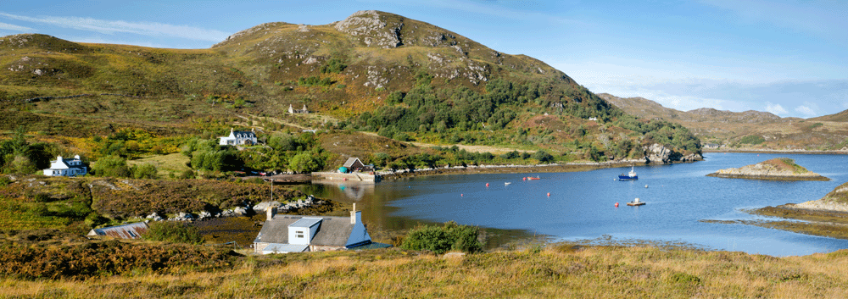
Summerisle Island
The Wicker Man

Slide 20
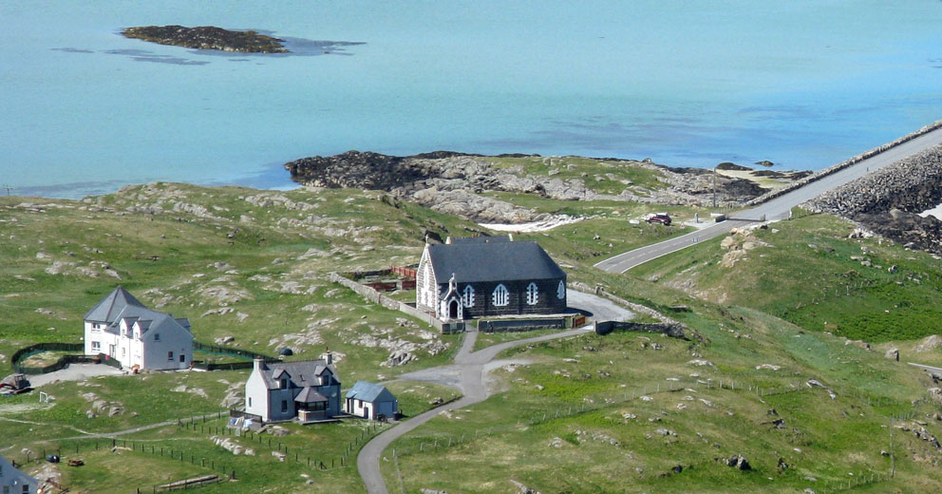
Eriskay Island
Whiskey Galore 1949

Slide 21
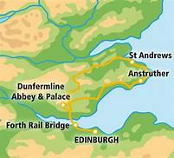
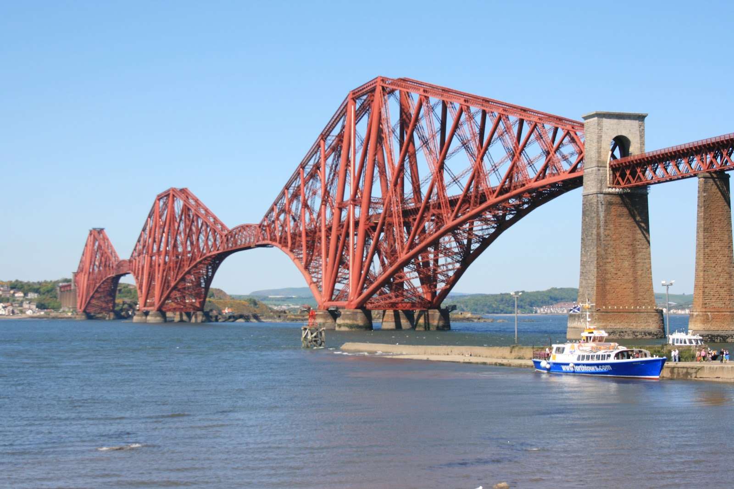
The Forth Bridge
The 39 Steps

